Slide 1


Derivation of Jacobian Matrix
For the 3-DOF articulated manipulator shown aside,
3x1 3x3 3x1
6x1 6x3 3x1
To derive the Jacobian, we need the position of the EE which
can be obtained from forward kinematics model.
⁰T₃=
So, position of the EE along X-axis (p_{ex}) = Cθ₁(L₃Cθ₂₃+L₂Cθ₂)………(1)
p_{ey}= Sθ₁(L₃Cθ₂₃+L₂Cθ₂) ……….(2)
p_{ez}= L₃Sθ₂₃+L₂Sθ₂……………....(3)
Picture taken from Robotics and Control by Nagrath and Mittal

Slide 2
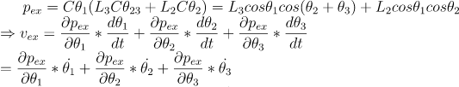
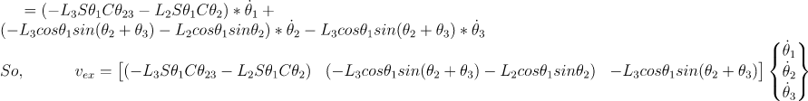
.............(4)

Slide 3
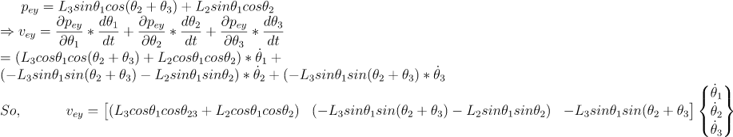
.............(5)

Slide 4
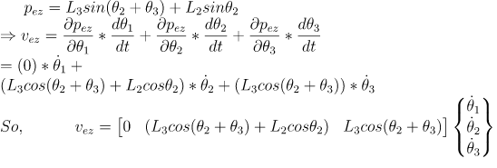
.............(6)

Slide 5
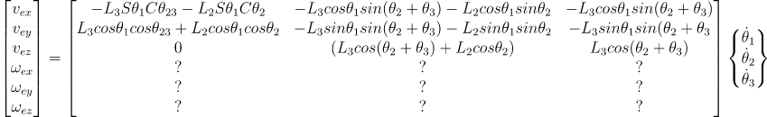
Combining Eqns 4,5 and 6,
In the beginning we had,
6x1 6x3 3x1

